Slide 1
FAMILY FEUD FAMILY FEUD FAMILY FEUD FAMILY FEUD FAMILY FEUD FAMILY FEUD FAMILY FEUD FAMILY FEUD FAMILY FEUD FAMILY FEUD FAMILY FEUD FAMILY FEUD FAMILY FEUD FAMILY FEUD FAMILY FEUD FAMILY FEUD FAMILY FE
FAMILY FEUD FAMILY FEUD FAMILY FEUD FAMILY FEUD FAMILY FEUD FAMILY FEUD FAMILY FEUD FAMILY FEUD FAMILY FEUD FAMILY FEUD FAMILY FEUD FAMILY FEUD FAMILY FEUD FAMILY FEUD FAMILY FEUD FAMILY FEUD FAMILY FE
© 2022 The Regents of the University of Michigan
Notes:
Family Feud Template
Introduction Slide – Family Feud!

Slide 2
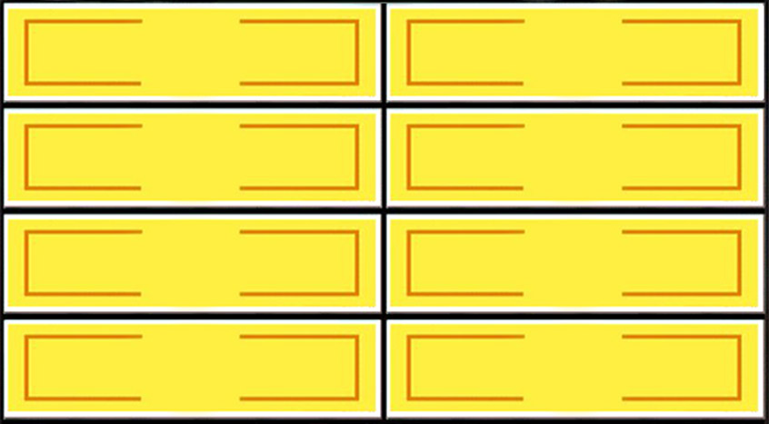
What are some consequences of having sex too early?
Round 1
X
X
X
X
X
X
X
X
X
Unwanted Pregnancy
15
Bad feelings
4
STDs
11
HIV/AIDs
8
Health Problems
5
X
X
X
© 2022 The Regents of the University of Michigan
Win
Lose
Cheer
Boo
Silence
Notes:
Family Feud Template
6 Panel Slide

Slide 3
What are some things you could say to delay sex?
Round 2
X
X
X
X
X
X
X
X
X
I’m not ready
49
I have to go
8
It’s not the right time
5
Not tonight
3
X
X
X
© 2022 The Regents of the University of Michigan
Win
Lose
Cheer
Boo
Silence
Notes:
Family Feud Template
6 Panel Slide

Slide 4
Who are some people you can consider talking to about sex?
Round 3
X
X
X
X
X
X
X
X
X
Father
21
Mother
17
Trusted Family Member
15
X
X
X
© 2022 The Regents of the University of Michigan
Win
Lose
Cheer
Boo
Silence
Notes:
Family Feud Template
7 Panel Slide

Slide 5
What are some outside influences that may spread unhealthy information about sex?
Round 4
X
X
X
X
X
X
X
X
X
TV shows
16
Movies
14
Friends
10
Music Videos
11
X
X
X
© 2022 The Regents of the University of Michigan
Win
Lose
Cheer
Boo
Silence
Notes:
Family Feud Template
8 Panel Slide

