Slide 1
Bullying
Fathers and Sons Program
© 2022 The Regents of the University of Michigan
Notes:
Facilitator Script
(Read the text in the boxes as you go through the PowerPoint slides)
Today we are going to talk about two types of violence—domestic violence and bullying.

Slide 2
Bullying
© 2022 The Regents of the University of Michigan
Notes:
The second half of this discussion is on bullying.
How do you describe bullying?
(WAIT FOR RESPONSES)

Slide 3
What is Bullying?
It’s bullying if:
One person is intentionally hurting or harming another person with words or behavior
The behavior is being done on purpose
The person who is doing it has more “power”
- ‘Power can mean the person bullying is older, bigger or stronger, more popular, or there’s a group of kids who “gang up” on someone.’ ⁵
© 2022 The Regents of the University of Michigan
Notes:
There are few different characteristics that define an action or actions as bullying.
It’s bullying if one person is intentionally hurting or harming another person with their words or behavior, if the behavior is being done on purpose, and if the person who is doing the bullying has more “power.”
When it comes to bullying, “power can mean the person bullying is older, bigger, stronger, more popular, or that there’s a group of kids who ‘gang up on someone.⁵’”

Slide 4
What are some types of bullying?
© 2022 The Regents of the University of Michigan
Notes:
Now we’re going to talk about four different types of bullying.
Can anyone name some of the different types of bullying?
(WAIT FOR RESPONSES)

Slide 5
Physical Bullying (Actions)
Beating up
Hitting/kicking
Poking
Pushing/tripping
Taking or breaking someone’s things
© 2022 The Regents of the University of Michigan
Notes:
The first type of bullying we’re going to discuss is physical bullying.
Physical bullying can include actions such as beating someone up, hitting, kicking, poking and pushing.⁶

Slide 6
Verbal Bullying (Words)
Insulting
Name-calling
Teasing
Yelling
Threatening to harm
© 2022 The Regents of the University of Michigan
Notes:
Another type of bullying is verbal bullying.
Verbal bullying happens when people use their words to insult, name call, tease, threaten to harm, and/or yell at other people.⁶

Slide 7
Social or Relational Bullying
Excluding
Spreading rumors
Getting others to hurt someone
© 2022 The Regents of the University of Michigan
Notes:
Social or relational bullying takes place when people exclude others, spread rumors about other people, or get others to hurt someone.⁶

Slide 8
Cyberbullying (Social Media)
Sending hurtful messages or images by Internet or cell phone
© 2022 The Regents of the University of Michigan
Notes:
Finally, cyberbullying is a form of bullying that includes sending hurtful messages or images using the internet or cell phones.⁶

Slide 9
Direct vs. Indirect Bullying
Bullying Comes in Many Different Forms
© 2022 The Regents of the University of Michigan
Notes:
The different forms of bullying can be direct or indirect.

Slide 10
DIRECT BULLYING CAN BE:
Teasing
Taunting
Threatening
Hitting
Pushing
Pinching
Stealing
Tripping
Destroying clothing, homework, etc.
Hurtful words
Cruel jokes or tricks
Making someone do something they don’t want to do
Ganging up on someone
© 2022 The Regents of the University of Michigan
Notes:
Direct forms of bullying can be hitting, stealing, destroying someone’s clothing or homework, making cruel jokes about someone, or making them do something they don’t want to do.⁷
Direct bullying occurs when someone does something directly to another person.

Slide 11
INDIRECT BULLYING CAN BE:
Intentional exclusion (“Don’t play with him”… “Don’t invite her”)
Spreading rumors or gossip
Ignoring or leaving someone out
Mean looks or rude gestures
Writing and passing cruel or threatening notes (or using email and forms of social media)
© 2022 The Regents of the University of Michigan
Notes:
Some examples of indirect bullying can be saying things like “Don’t play with him” or “Don’t invite her,” spreading rumors about someone or leaving someone out.⁷
Although someone may not be directly hitting or kicking another person, indirect bullying is still harmful.

Slide 12
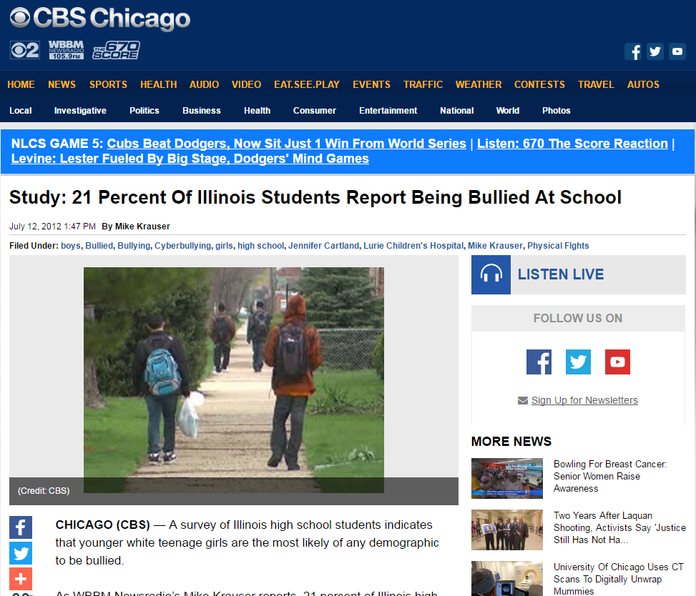
Place your screenshot here
© 2022 The Regents of the University of Michigan
Notes:
It is important to understand the different forms of bullying because bullying can affect anyone and cause them to have negative experiences.
A past study in the state of Illinois found that 21% of students report being bullied at school--that’s approximately one out of every 5 students. It also possible that the number is even higher because some students may not have wanted to say that they were being bullied.

Slide 13
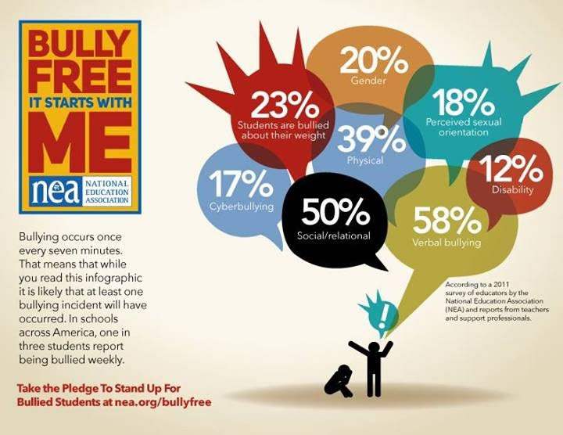
© 2022 The Regents of the University of Michigan
Notes:
This picture shows some of different forms of bullying people experienced or reasons why they were bullied.
As we can see, students are experiencing many different forms of bullying and are being bullied for a variety of reasons.

Slide 14
© 2022 The Regents of the University of Michigan
Notes:
It is also important to know that bullying can happen anywhere.
This can make students feel unsafe or anxious to go to school or even use technology.

Slide 15
What percentage of teens have been bullied through their phones or the internet?
© 2022 The Regents of the University of Michigan
Notes:
With the rise in technology and social media we have also witnessed more cyberbullying.
What percentage of teens do you think have been bullied through their phones or the internet?
(WAIT FOR ANSWERS, THEN GO TO NEXT SLIDE)

Slide 16
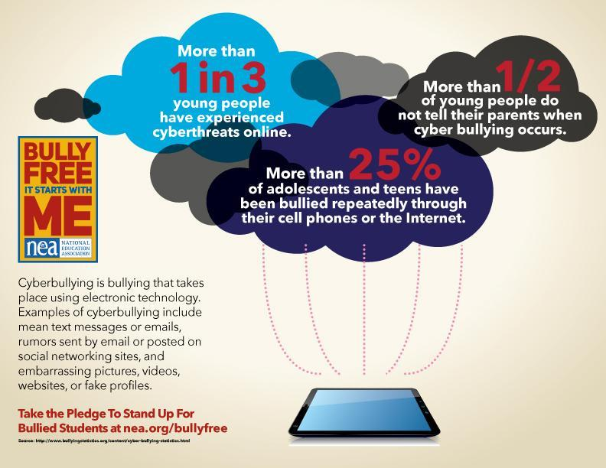
© 2022 The Regents of the University of Michigan
Notes:
According to the National Education Association, “more than 25% of teens have been bullied repeatedly through their cell phones or the internet.⁸”

Slide 17
Effects of bullying
Kids who are bullied are more likely to experience:
Depression and anxiety
Increased feelings of sadness and loneliness
Health complaints
Lower academic achievement– GPA, test scores—and school participation
© 2022 The Regents of the University of Michigan
Notes:
Bullying can lead to a lot of negative effects for those involved.
People who experience bullying are more likely to experience “depression and anxiety, have increased feelings of sadness and loneliness, have health complaints, and be lower academic achievement and school participation.⁸”

Slide 18
Effects of bullying
Kids who bully others are more likely to:
Abuse alcohol and other drugs as they get older
Get into fights, vandalize property, and drop out of school
Have criminal convictions as adults
Be abusive toward their romantic partner, spouse, or children as adults
© 2022 The Regents of the University of Michigan
Notes:
There are also negative effects for those who are the bullies.
People who bully others are more likely to “abuse alcohol and other drugs as they get older, get into fights and drop out of school, be convicted of crimes as adults, and be abusive towards their romantic partner or children.⁸”

Slide 19
Effects of bullying
Kids who witness bullying are more likely to:
Have increased use of tobacco, alcohol, or other drugs
Have increased mental health problems, including depression and anxiety
Miss or skip school
© 2022 The Regents of the University of Michigan
Notes:
Finally, kids who witness bullying are more likely to “have increased use of tobacco, alcohol or other drugs, have increased mental health problems such as depression and anxiety, and miss or skip school.⁸”

Slide 20
What Role Do You Play?
Kids who Bully:
Engage in bullying behavior
towards their peers
Kids who are Bullied:
Are the targets of bullying behavior
Kids who Assist:
May encourage the bullying
behavior and occasionally join in
Kids who Defend:
Actively comfort the child being bullied and may come to the child’s defense when bullying occurs
Kids who Reinforce:
Give the bully an audience by laughing or providing support for those who are engaging in bullying
Outsiders:
Remain separate from the bullying situation. They neither reinforce the bullying behavior nor defend the child being bullied
Stopbullying.gov
© 2022 The Regents of the University of Michigan
Notes:
When thinking about bullying situations, it’s important to think about what role you play.
Are you someone who bullies other kids?
Do you encourage bullying behavior or join in or are you the kid who gives the bully an audience by laughing when they are bullying someone?
Maybe you are someone who has been bullied?
Do you consider yourself to be someone who defends those who are bullied or are do you stay away from the bullying situation altogether?
Thinking about our role in bullying situations helps us determine whether we are promoting negative behavior or positive behavior.

Slide 21
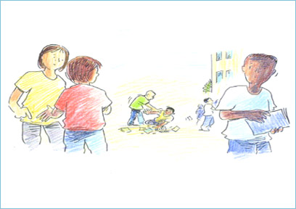
Be More Than a Bystander
Be their friend
Tell a trusted adult
Help them get away
Don’t give bullying an audience
Set a good example
© 2022 The Regents of the University of Michigan
Notes:
If you consider yourself to be someone who stands by and watches when someone is being bullied you should know that there are ways you can help prevent bullying.
Some things you can do are be their friend, tell a trusted adult, and/or help them get away.
You can also help by not giving the bullying an audience and setting a good example for your peers through your actions.

Slide 22
One thing we CAN do
RESIST ALLOWING DIRECT
OR INDIRECT BULLYING
© 2022 The Regents of the University of Michigan
Notes:
We can all work to prevent bullying by speaking up and not bullying others.

Slide 23
© 2022 The Regents of the University of Michigan
Notes:
(END OF PRESENTATION)

Slide 24
References
Pacer Center. (2013). Bullying 101. http://www.pacerkidsagainstbullying.org/wp-content/uploads/2014/07/bullying1014.pdf
Charity Sub. (n.d.) Bullying. https://www.charitysub.org/bullying/
Chicago Department of Public Health. (n.d.) Bullying Prevention. https://www.cityofchicago.org/city/en/depts/cdph/supp_info/violence_prevention/bullying_prevention.html
National Education Association. (2011). Bully Free: It start’s with me. http://www.nea.org/home/63948.htm
U.S. Department of Health and Human Services. (n.d.) Effects of Bullying. https://www.stopbullying.gov/at-risk/effects/
Edutopia. (n.d.) Bullying Prevention. https://www.edutopia.org/blogs/tag/bullying-prevention
© 2022 The Regents of the University of Michigan

Slide 25
Image Citations
http://chicago.cbslocal.com/2012/07/12/study-21-percent-of-illinois-students-report-being-bullied-at-school/
https://www.charitysub.org/bullying/
http://www.nea.org/home/63948.htm
https://i.ytimg.com/vi/SJ4eJzYRc8Q/maxresdefault.jpg
http://www.kenrigby.net/resources/KENRIGBY/files/RnztvIYbhgzmwviibdhcjhiae.jpg
https://www.edutopia.org/article/bullying-prevention-resources
https://students.usask.ca/images/icons/healthy-relationships.png
https://tlcinstitute.files.wordpress.com/2010/10/stop-bullying-small.png
© 2022 The Regents of the University of Michigan

Slide 26
Credits
Special thanks to all the people who made and released these awesome resources for free:
Presentation template by SlidesCarnival
Photographs by Unsplash
Backgrounds by Pixeden
© 2022 The Regents of the University of Michigan

